Slide 1
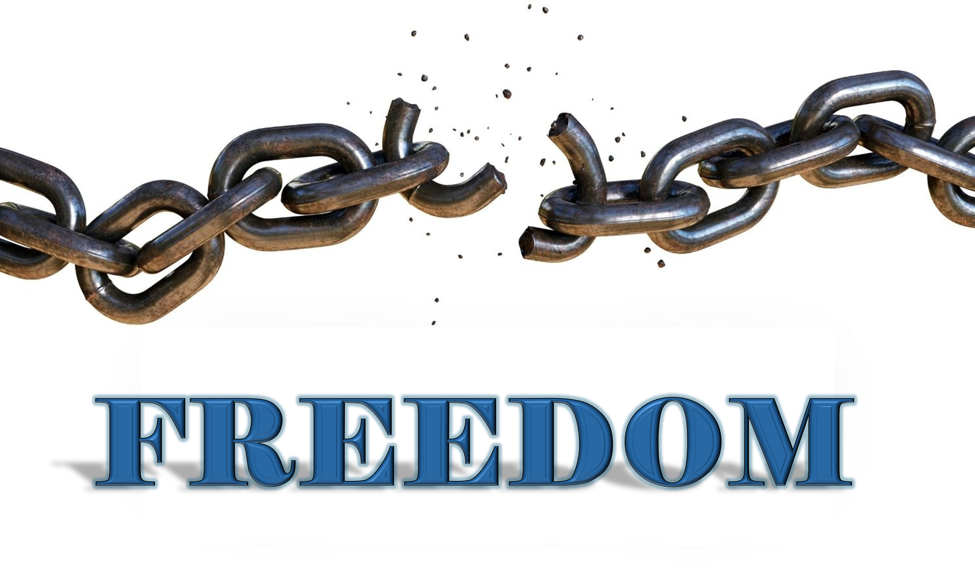

Slide 2
It is for freedom that Christ has set us free.
Stand firm, then, and do not let yourselves be burdened by the yoke of slavery
Galatians 5:1

Slide 4
Questions
When you are doing a project, do you find yourself taking extra time to make sure that it is done perfectly?
Do you care more about being respected than love?
Do you feel shame about yourself when you don’t meet your standard?
Do you often look down on people who have a different standard?

Slide 5
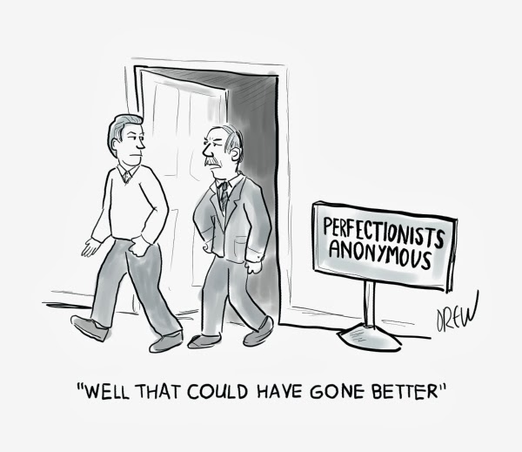

Slide 6
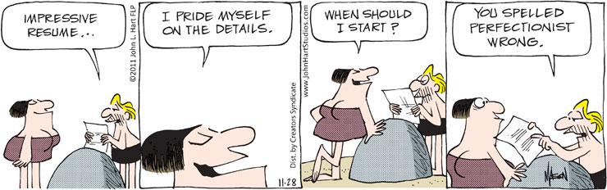

Slide 7
The Promise of Perfection
Makes you worthy of God
Earns the admiration of others

Slide 9
“Therefore, there is now no condemnation for those who are in Christ Jesus, because through Christ Jesus the law of the Spirit who gives life has set you free from the law of sin and death. For what the law was powerless to do because it was weakened by the flesh, God did by sending his only Son in the likeness of sinful flesh to be a sin offering. And so he condemned sin in the flesh, in order that the righteous requirement of the law might be fully met in us, who do not live according to the flesh but according to the spirit.”
Romans 8:1-4

Slide 10
II. The Cost of Perfectionism
  A continuing voice of condemnation
  A spirit of judgmentalism

Slide 11
III. The Freedom of the Gospel
  Jesus is perfect, so we don’t have to be
  There is no condemnation in Christ Jesus
  Communion with God transforms our hearts

